Slide 1
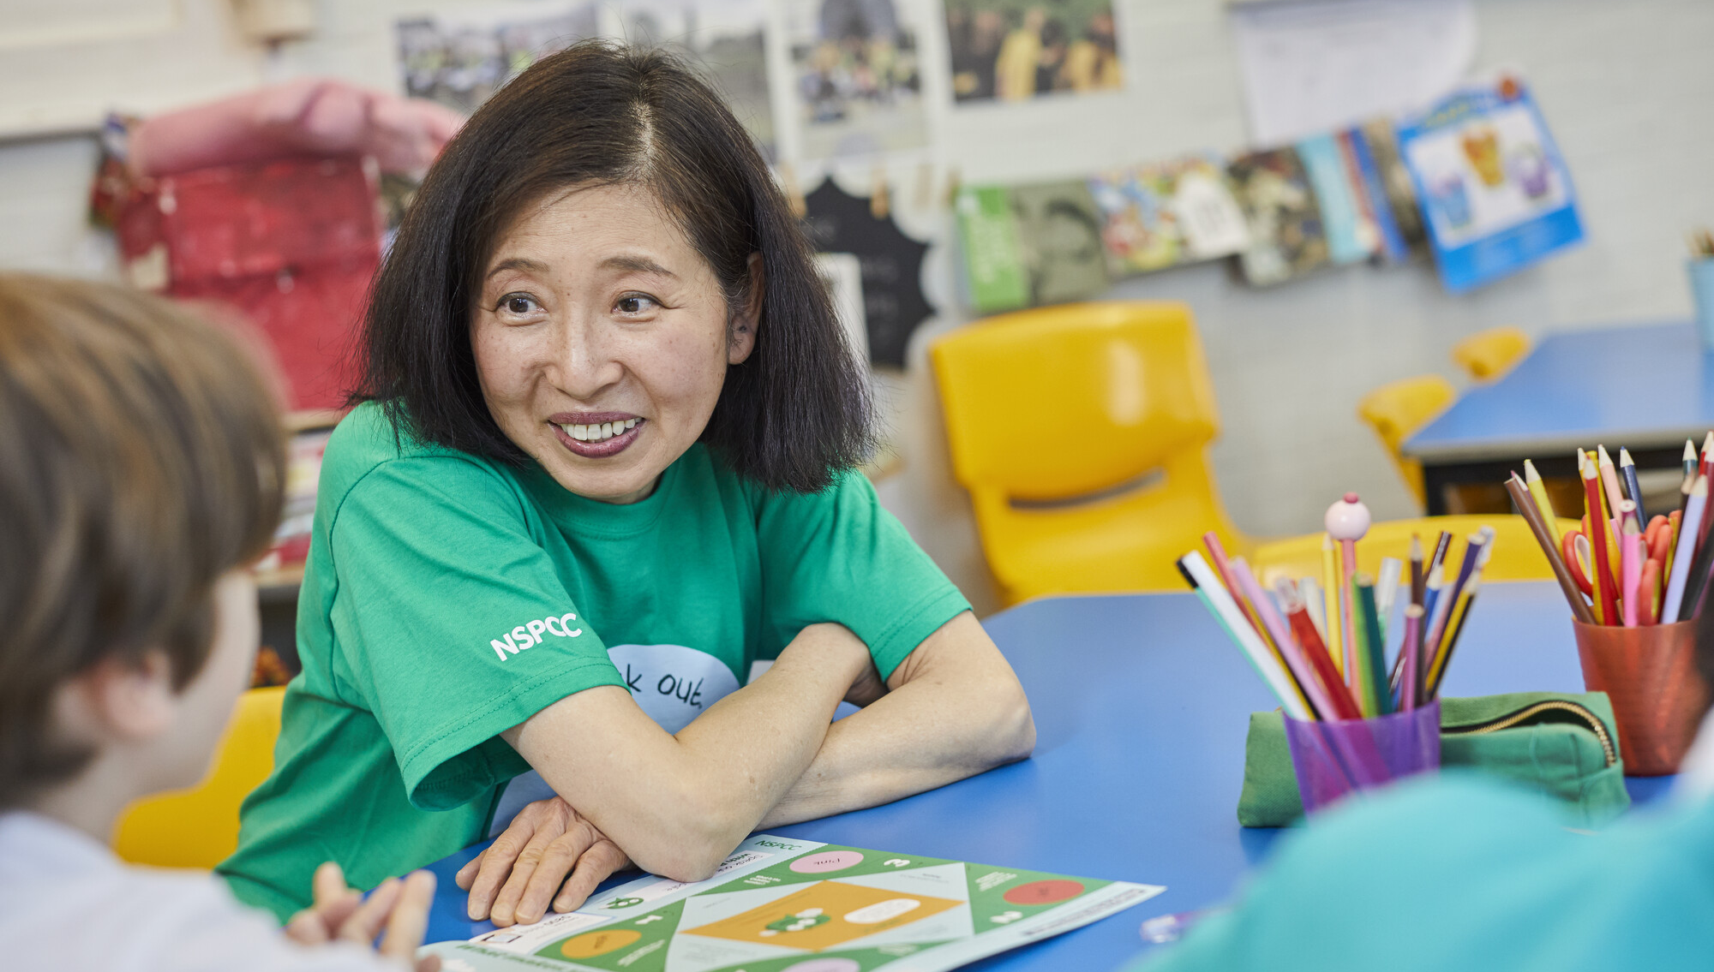



Achieving more, together.

Slide 2
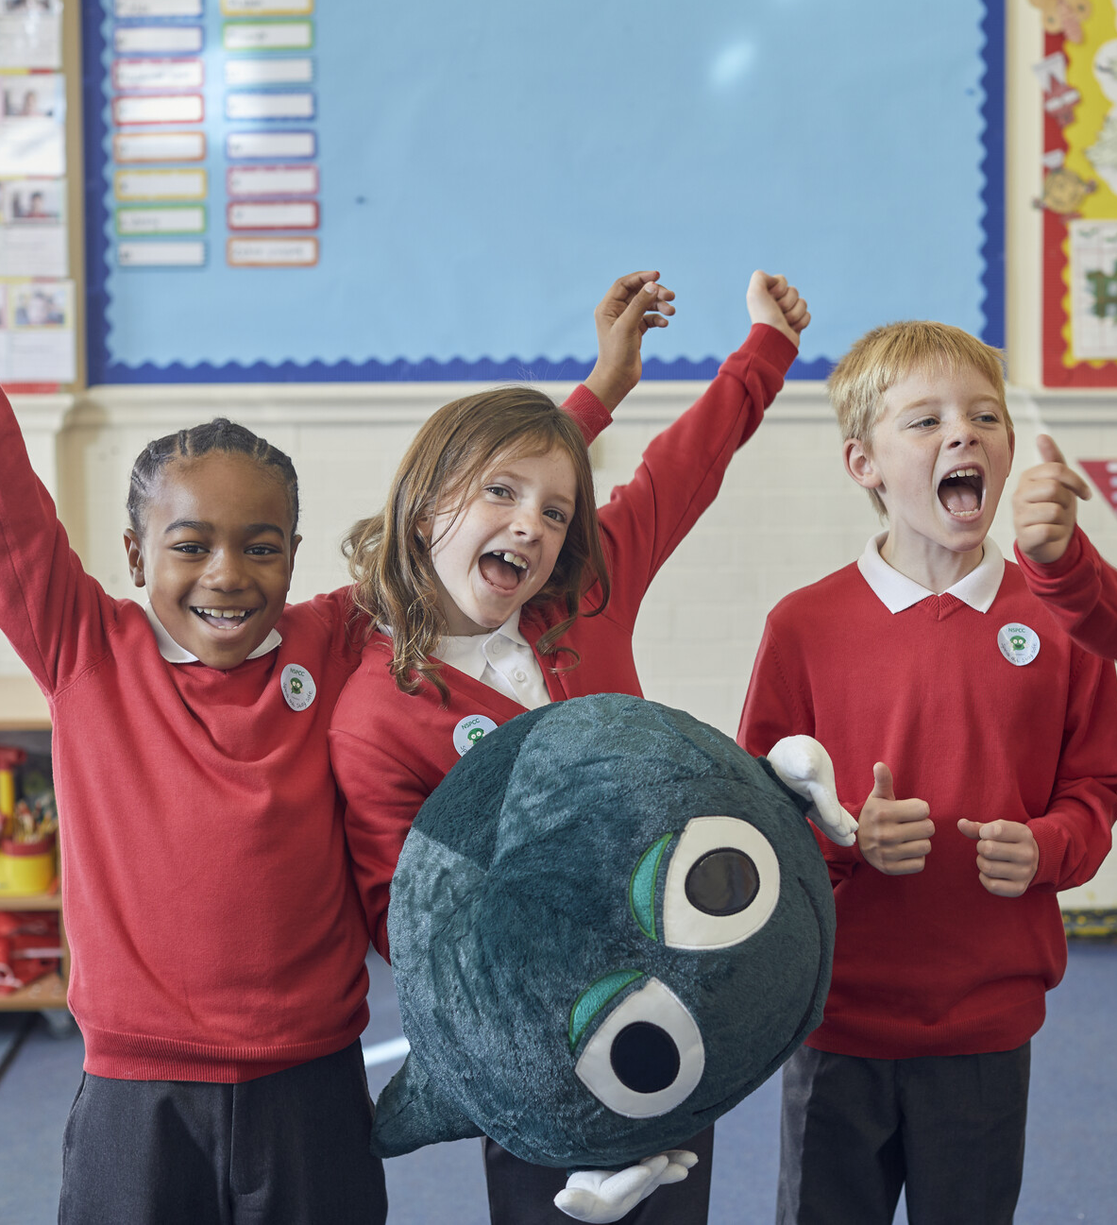
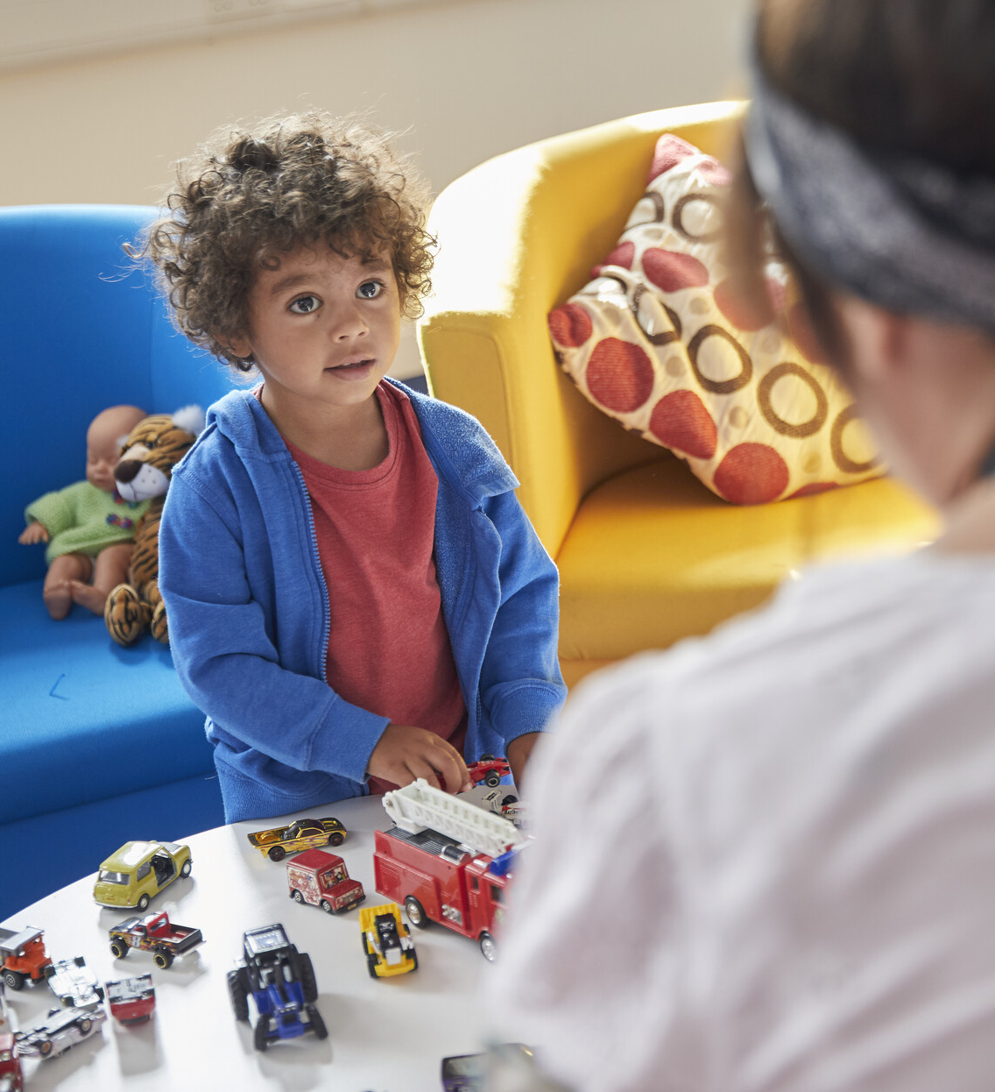
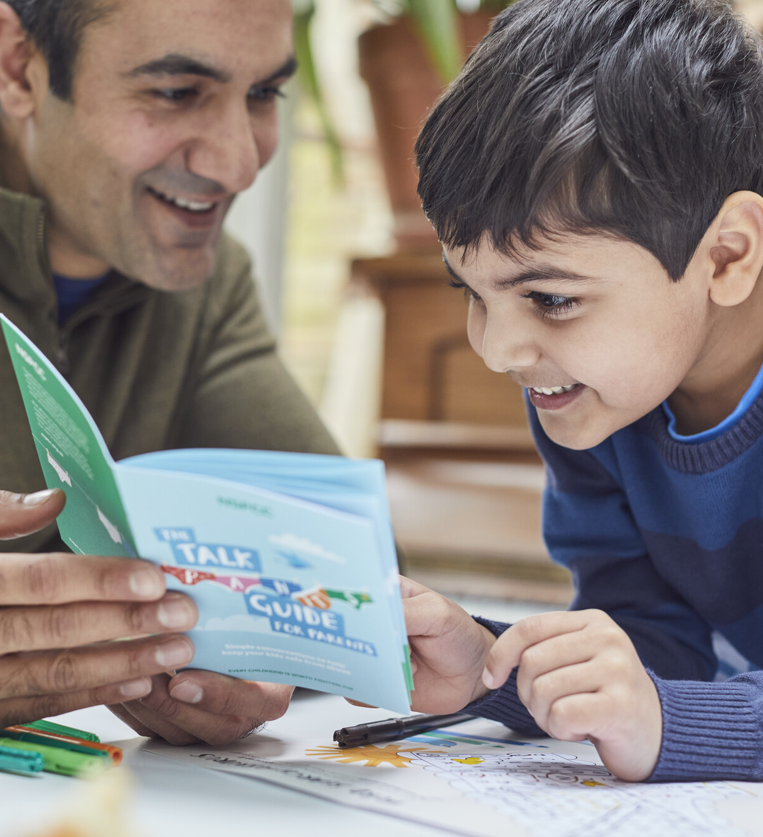
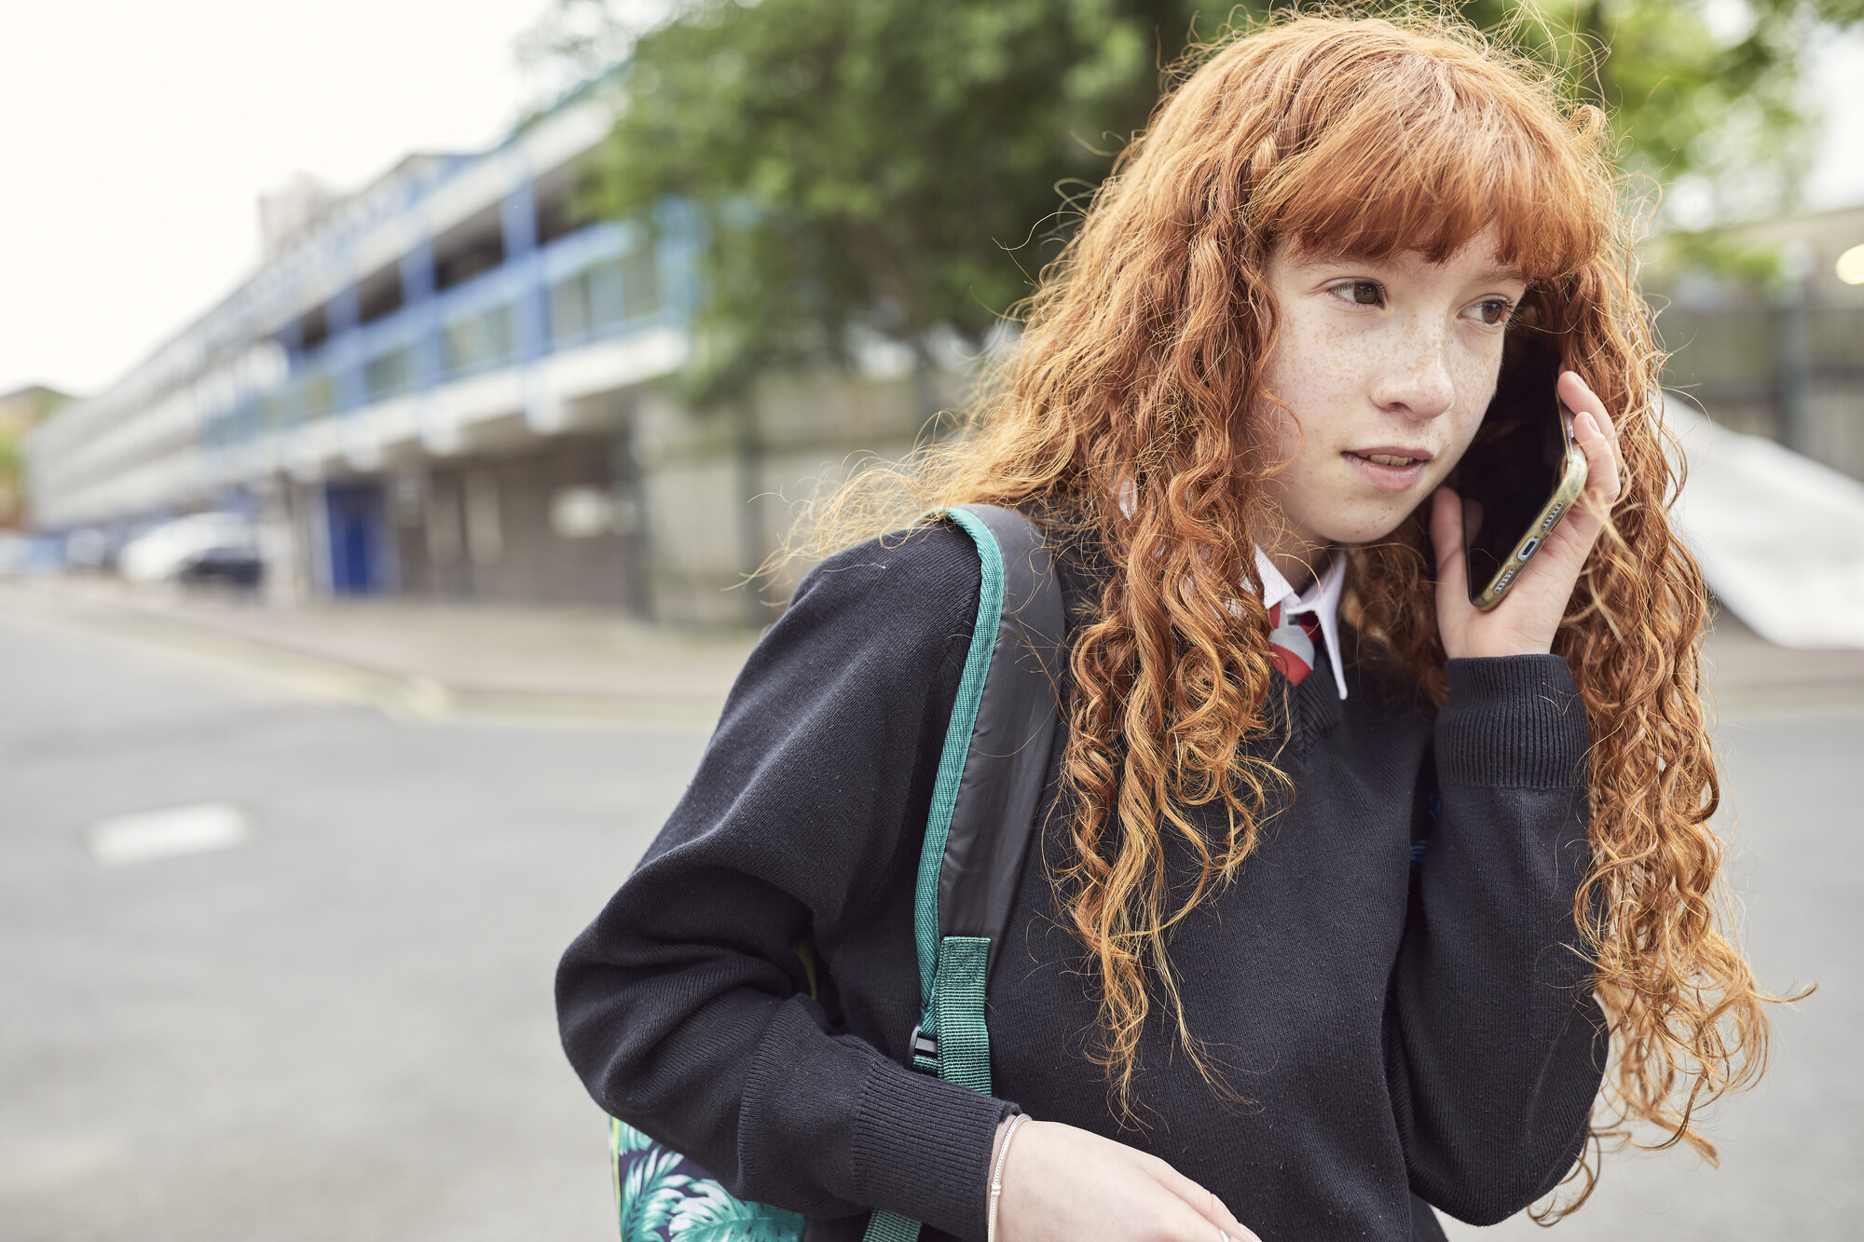
Why we exist
In the average primary school
Class, at least 2 children have suffered abuse or neglect.
But the numbers only ever tell half the story.
Behind every number is a real child.
But it doesn’t have to be this way.
The NSPCC has been fighting to keep families
safe, happy and well for over 100 years.
Above all, we need to work together. Because we
know that we can’t stop child abuse alone.
We hope JMK Solicitors will join us, and
create a legacy to be proud of.

Slide 3
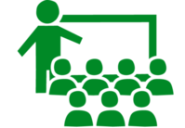
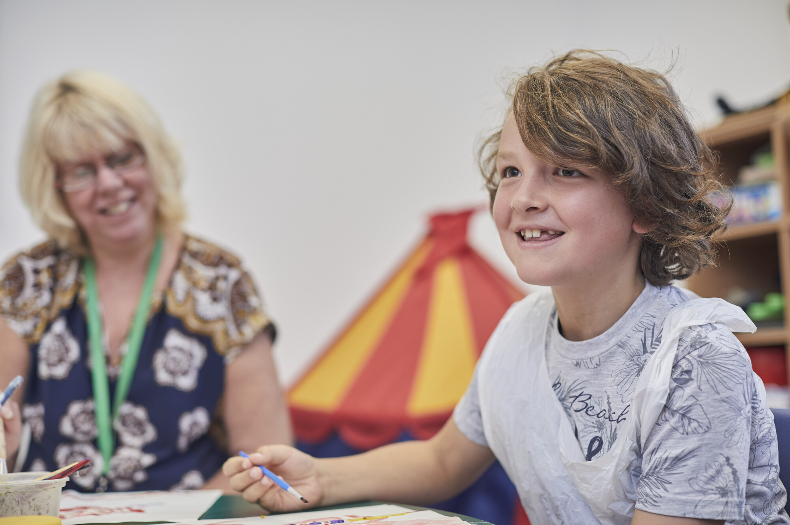
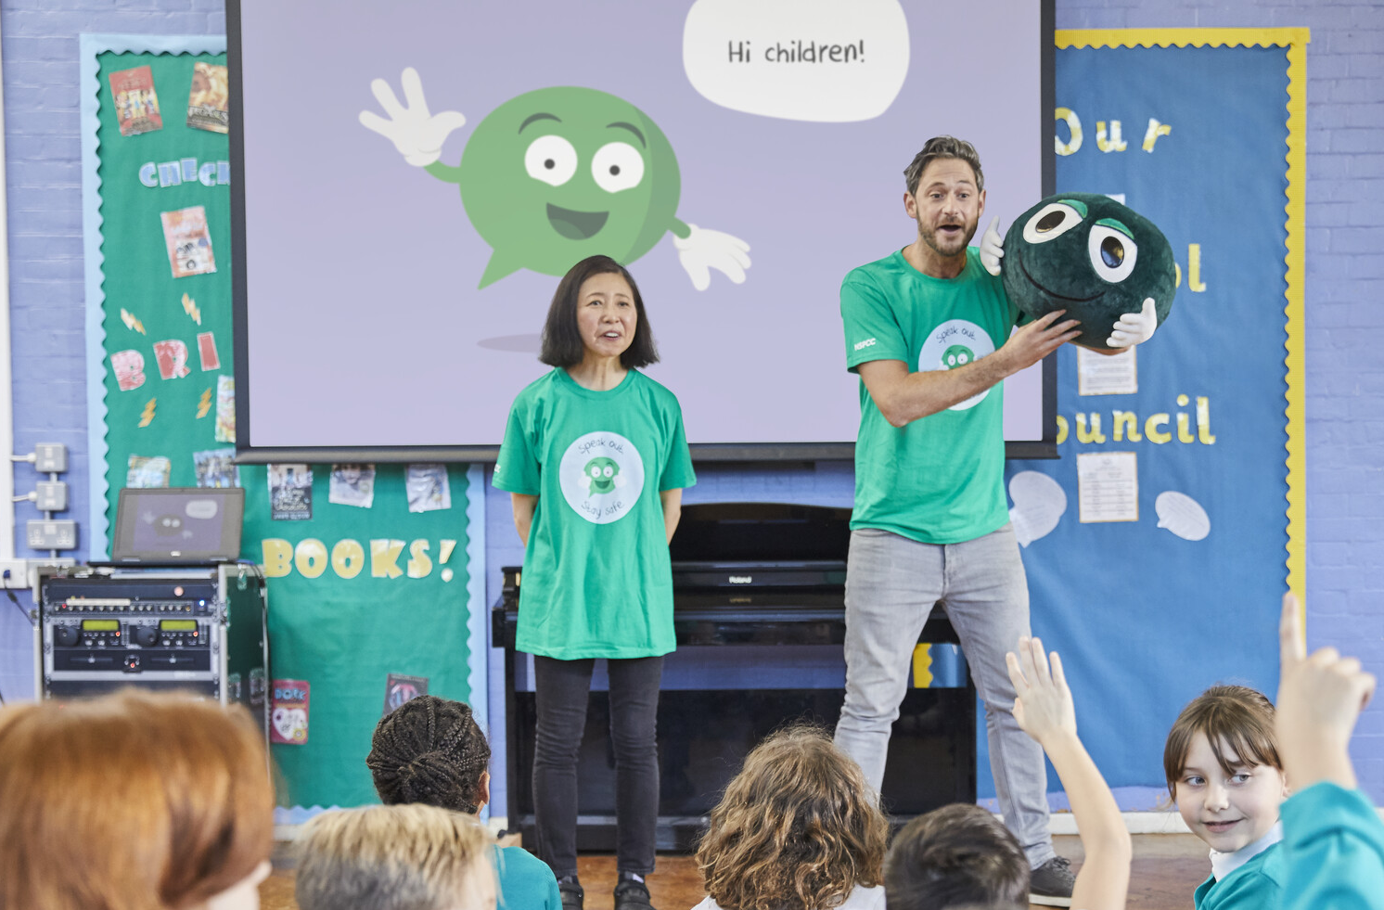
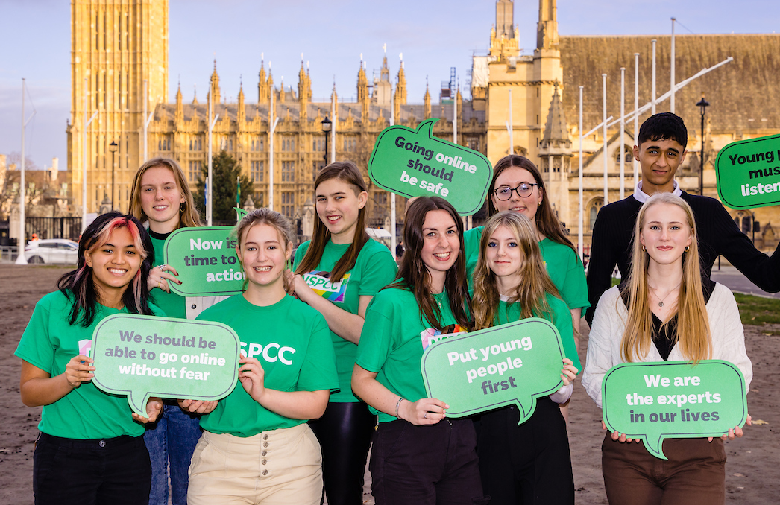


What we do at a glance
  The NSPCC was founded in 1884. For almost 140 years,
  we’ve been fighting to make child abuse a thing of the past.
7 children in
a classroom
Experience abuse
before they turn 18.
On average, a child contacts Childline
every 25 seconds
On the frontline
We are ready to listen, reassure, and take action to keep children safe. And we support children and families – to stop abuse from happening and help
them recover if it does.
Educating and empowering
We teach children to recognise abuse, understand it’s never their fault, and know where to turn to for help. And we support adults to protect children.
Campaigning for change
We fight for changes that
will make society safer for
children – always backed up
by what we’ve learnt from
the children we exist to help.
150
adults a day
call our Helpline concerned about a child’s welfare.
Together we can stop child abuse and neglect.

Slide 4




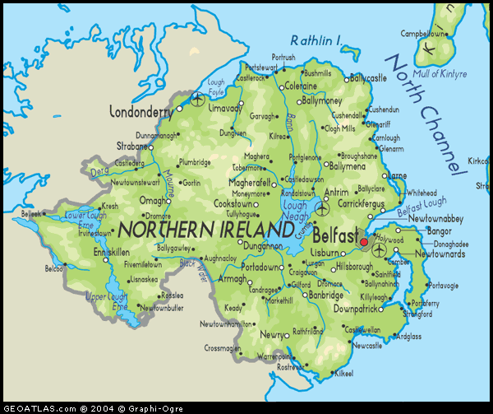

Across Northern Ireland
Foyle Service Centre
Childline Foyle
Belfast Service Centre
Childline Belfast
Helpline
Schools Service
Young Witness Service in all NI Crown Courts
NI Child Protection in Sport Clubs and Organisations
Campaigning

Slide 5
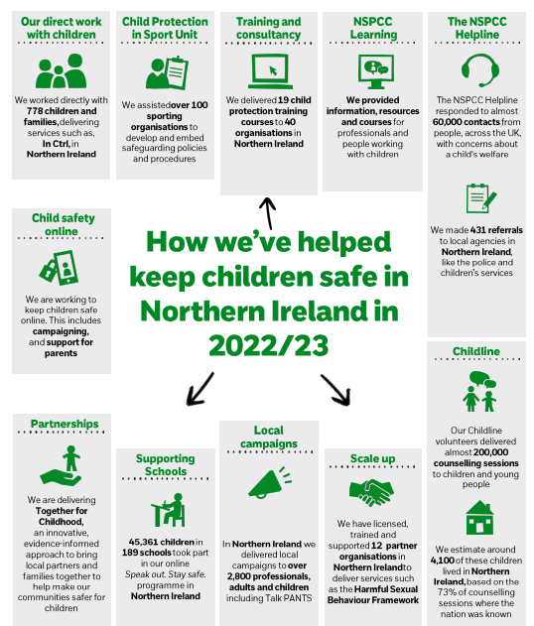
Our Impact Across Northern Ireland

Slide 6
The change we want to see by 2031
Everyone plays their part
to prevent child abuse.
Every child is safe online.
Children feel safe,
listened to and supported.

Slide 7
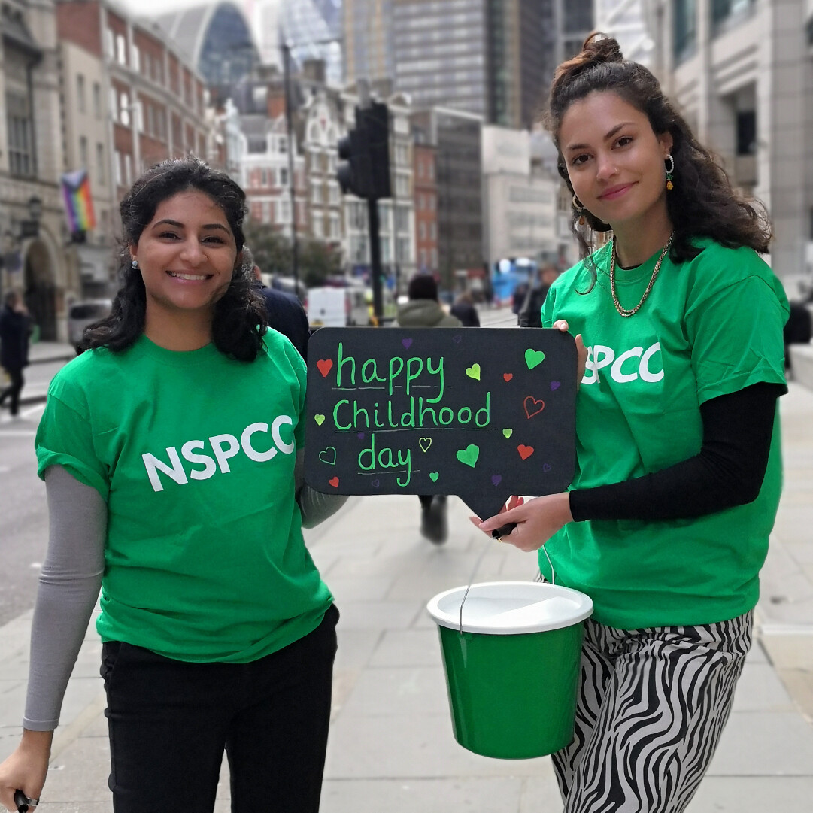
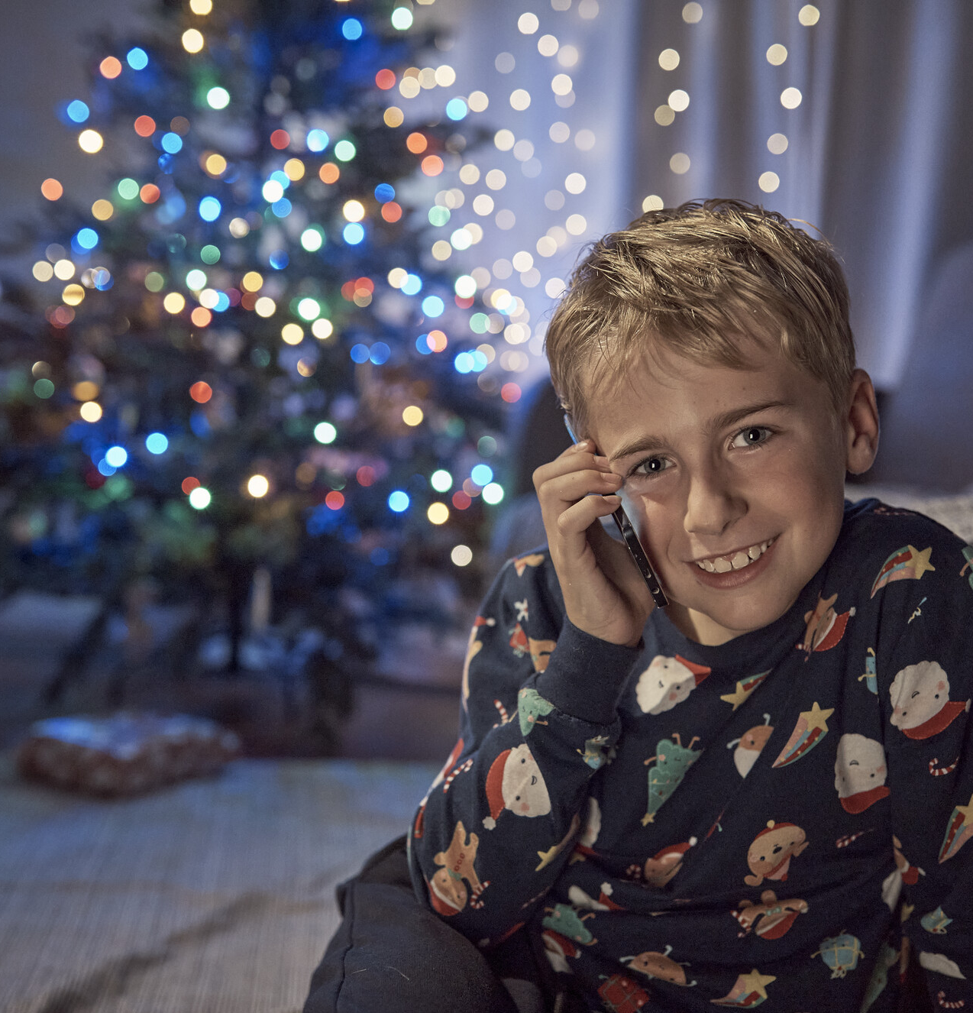
Our key annual moments
Childhood Day
This is our annual, landmark day, on the second Friday of June. The aim is to bring communities together to make child protection a top priority. It’s another step towards breaking the taboo around the topic and bringing it to the forefront of public discussion. Childhood Day is full of fun and fundraising, last year inviting participants to embrace the benefits of play, and this year encouraging them to take part in a Childhood Day Mile. The day is a crucial engagement tool for the public and our work.
There are flagship moments throughout the year when we know that children will benefit from active campaigns from us. They’re opportunities to raise awareness of our work, encourage conversation around child safety, and raise money. We’re always looking for creative ways to partner with brands around these moments.
Christmas
There were over 5,500 Childline counselling sessions between 24th December 2022 and 4th January 2023.
There were 1,294 contacts to the NSPCC Helpline between 24th December 2022 and 4th January 2023.
Every holiday period we run a campaign to remind the public that children’s problems don’t stop over the most magical time of year.

Slide 8
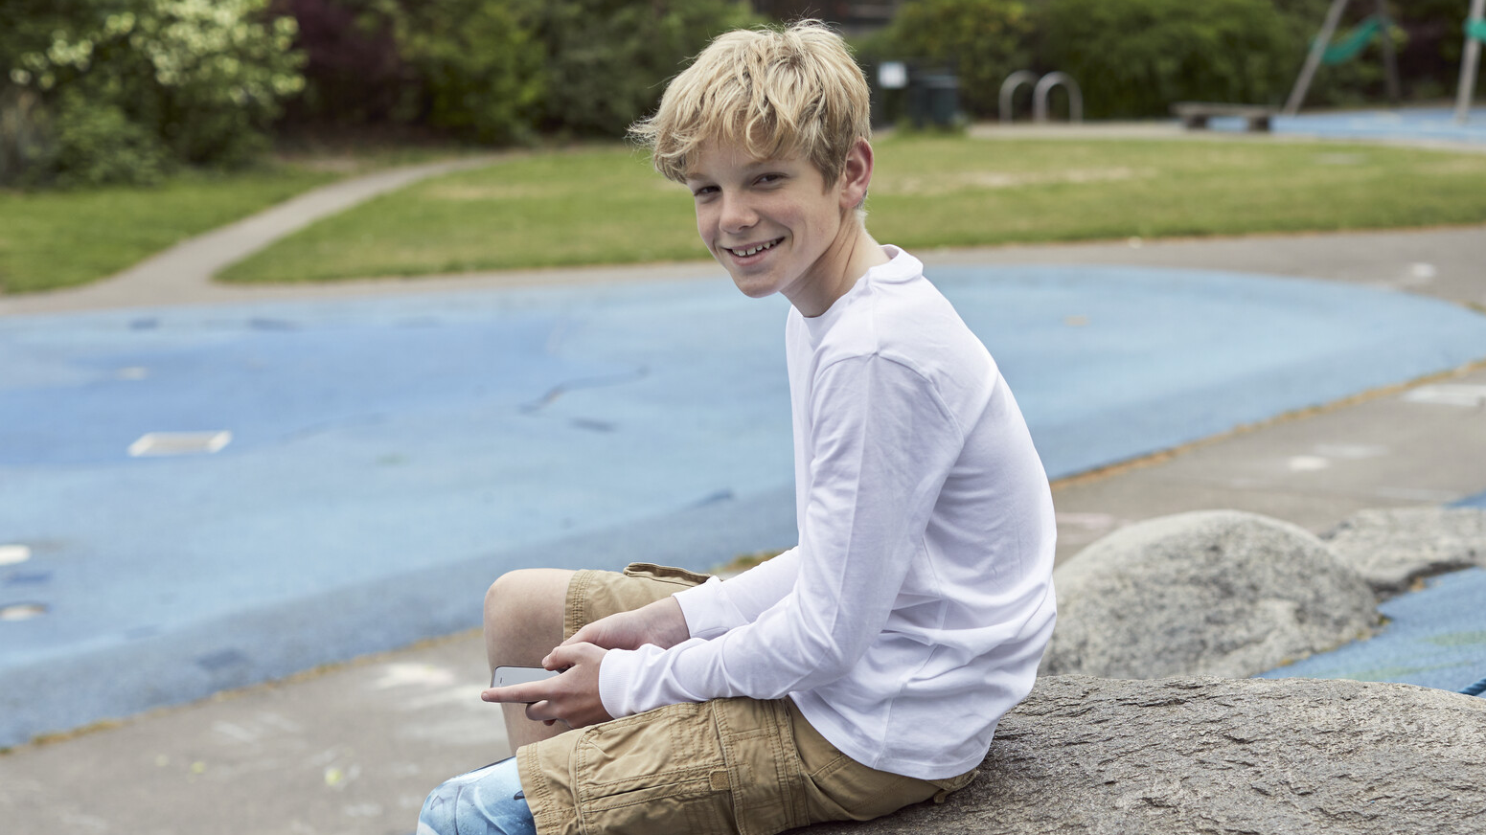


NSPCC Brand: our loved and trusted brand
Protecting children from abuse and neglect is the 2nd most important cause for concern in society.
We have consistently been named as the top children’s charity in the UK, when the public are asked by YouGov who they would like to donate to.
Lindt saw an 18.2% uplift in sales of their Christmas chocolate teddy following a cause-related marketing campaign with the NSPCC.
1 in 3 Consumers would be more likely to purchase products from a retailer that partnered with the NSPCC, compared to a similar company that did not.

Slide 9
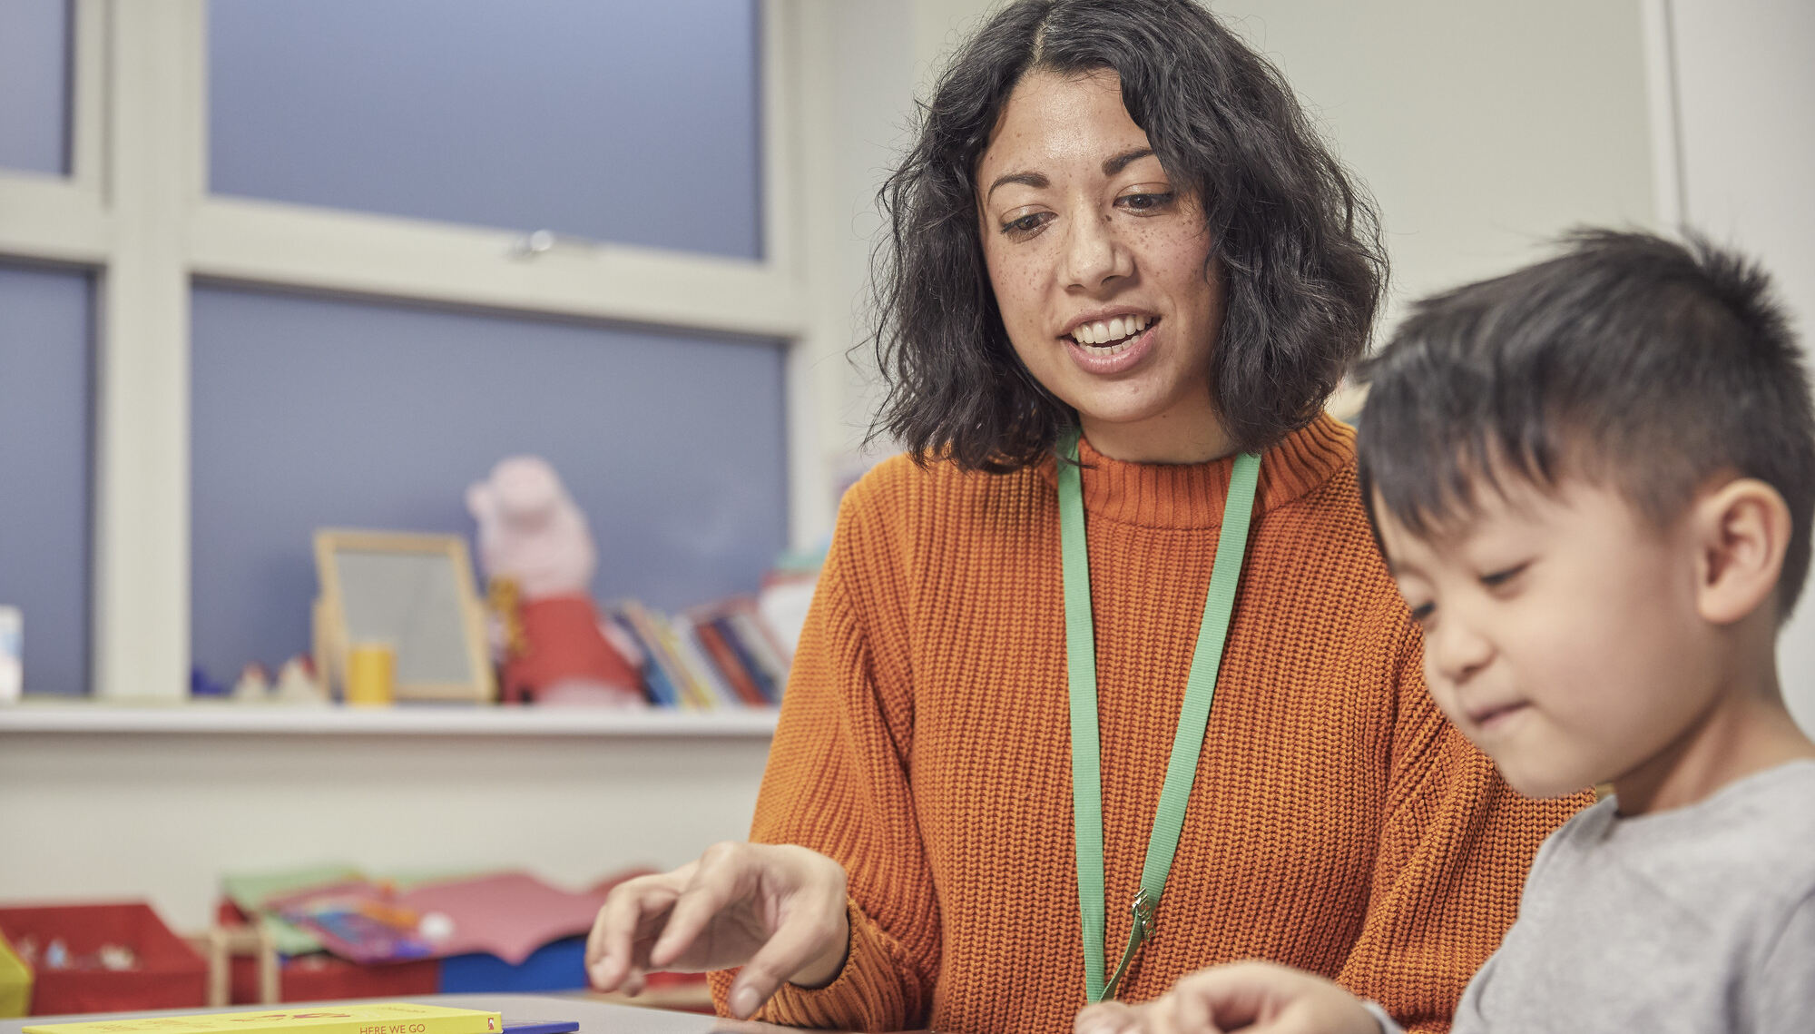
How you
can make
an impact

Slide 10

JMK Solicitors, please choose NSPCC as your next charity partner.
Help us be here for every child.
NSPCC's vision is that together, we can stop child abuse and neglect.
The difference we want to make
Goal 1 - Everyone plays their part to prevent child abuse
Goal 2 - Every child is safe online
Goal 3 - Children feel safe, listened to and supported
Without support, this could derail children's lives
7 Children in a classroom experience abuse before they turn 18
In 2022 the Internet Watch Foundation confirmed
over 255,500 reports as containing child sexual abuse images
Half of mental health conditions in adults start before the age of 14.
55% of Childline counselling sessions are about mental/ emotional health and wellbeing.
“I want to thank the counsellor
for saving my life. People have come and gone from my life. Childline has always been there.”
Childline caller, aged 14
JMK Solicitors, no child should suffer abuse. Children have never needed your support more.
Today, you have a chance to make an amazing difference in children's lives in the UK.
Please join us, vote for the NSPCC. Together we can change children's lives.

Slide 11
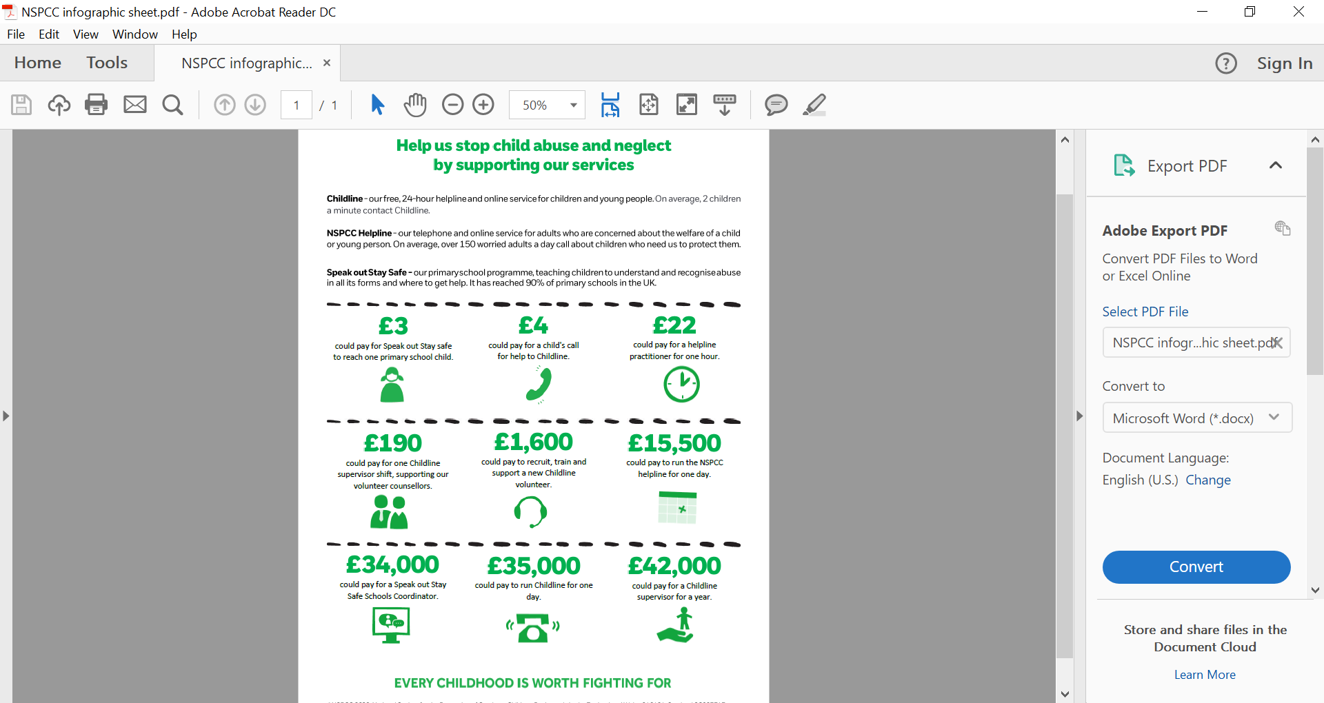
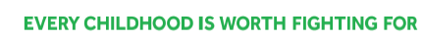
Help us to stop child abuse and neglect

Slide 12
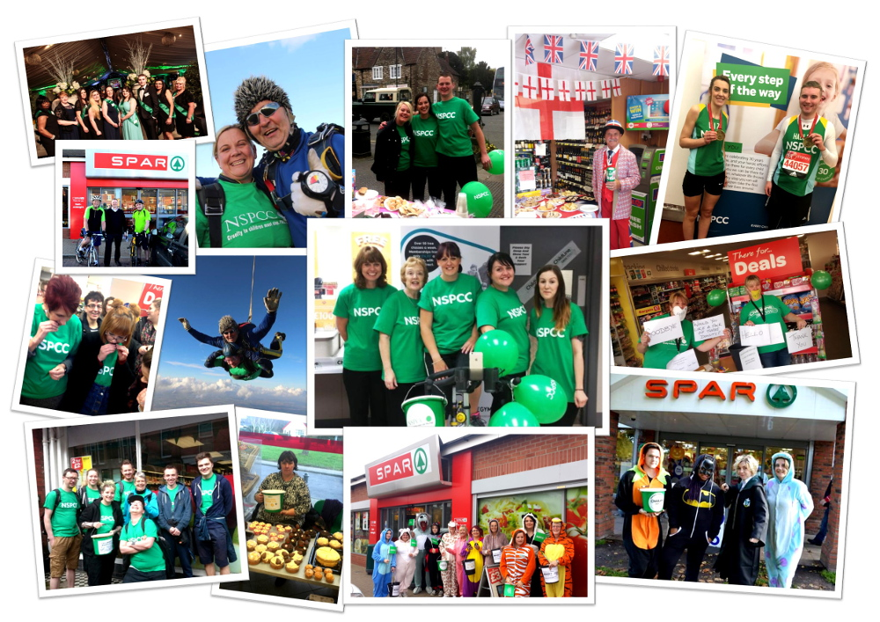
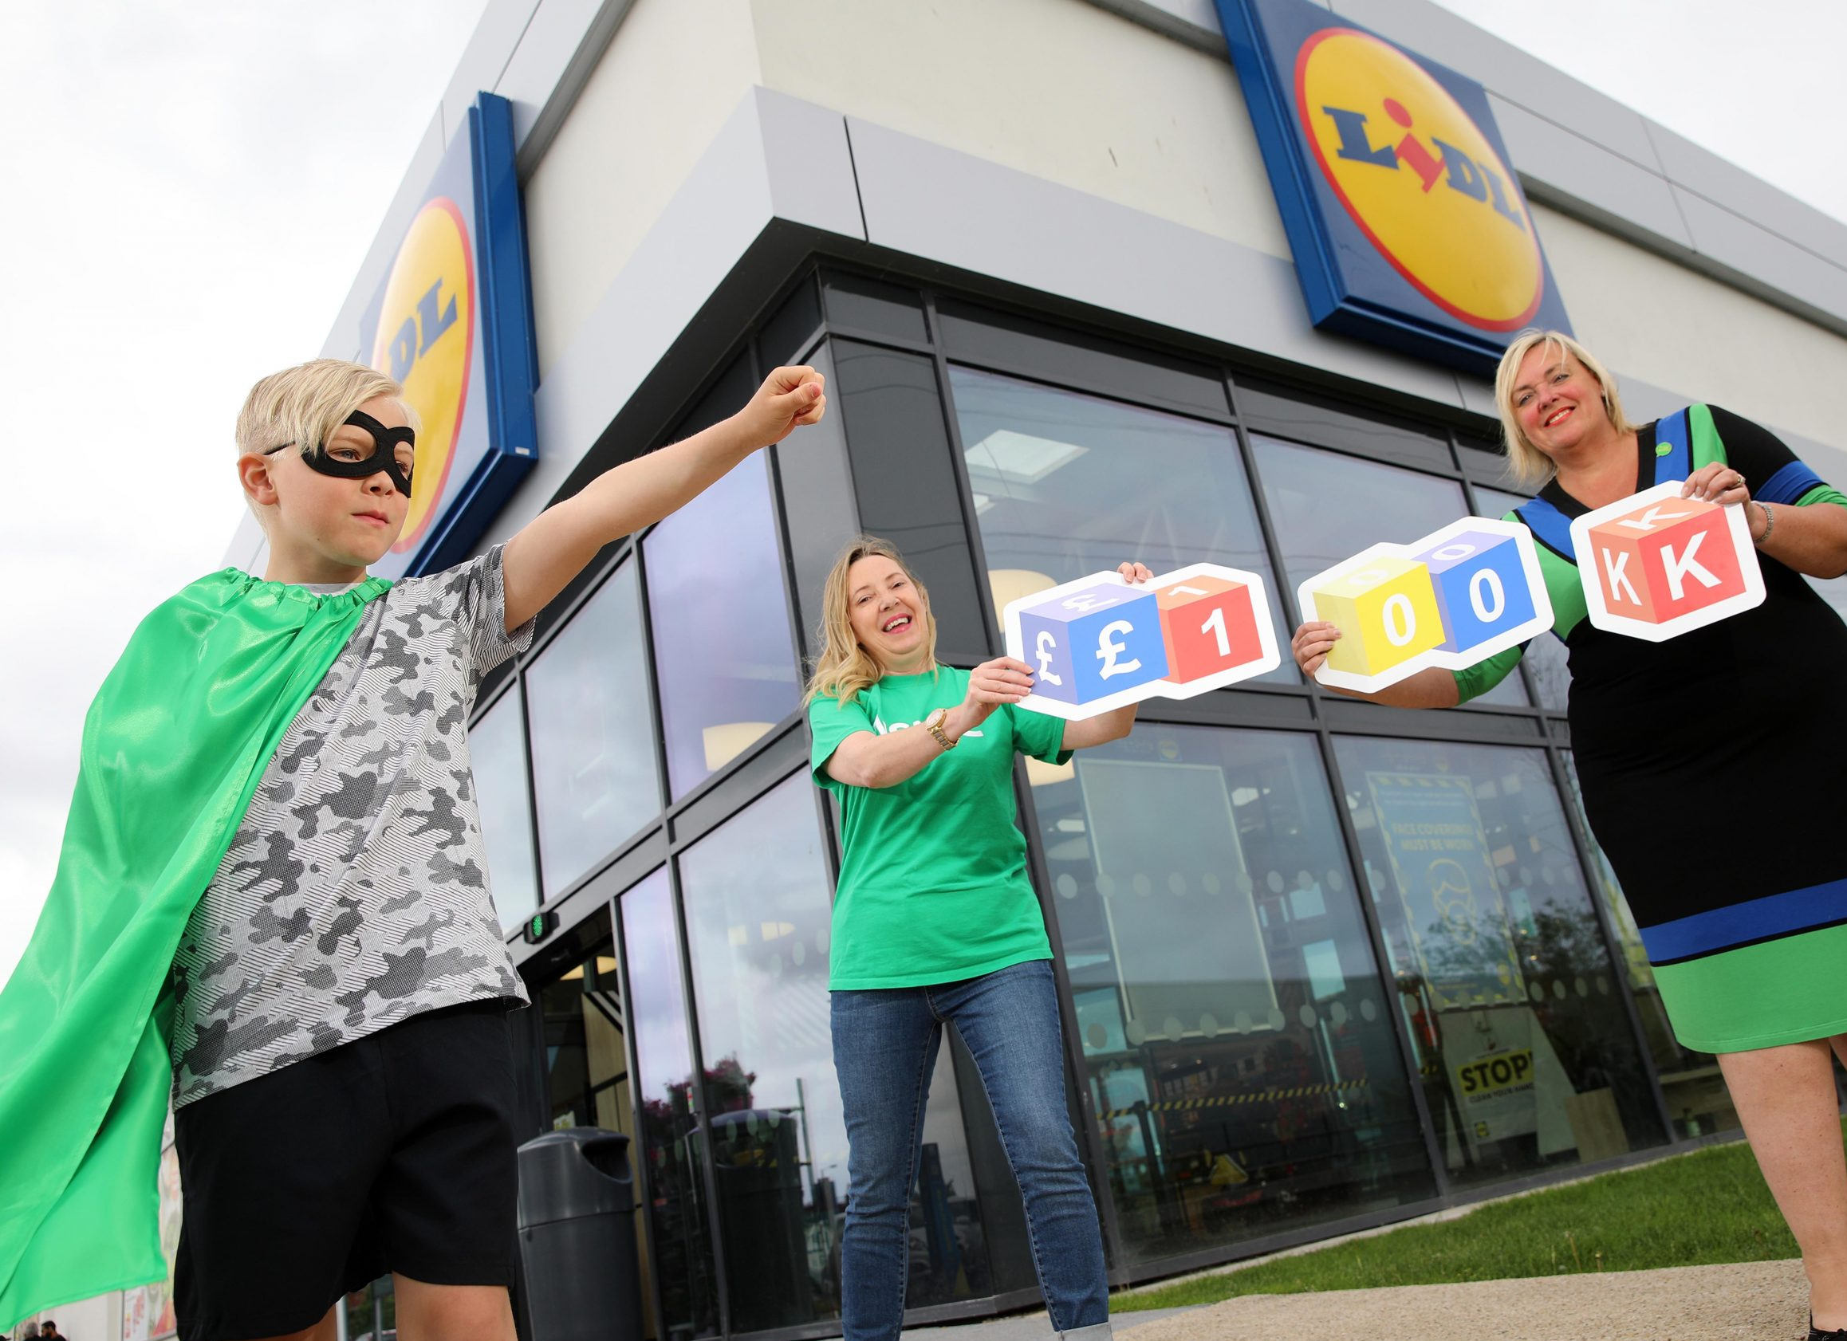
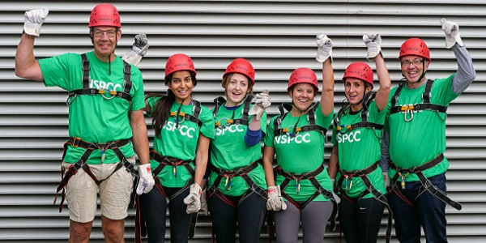
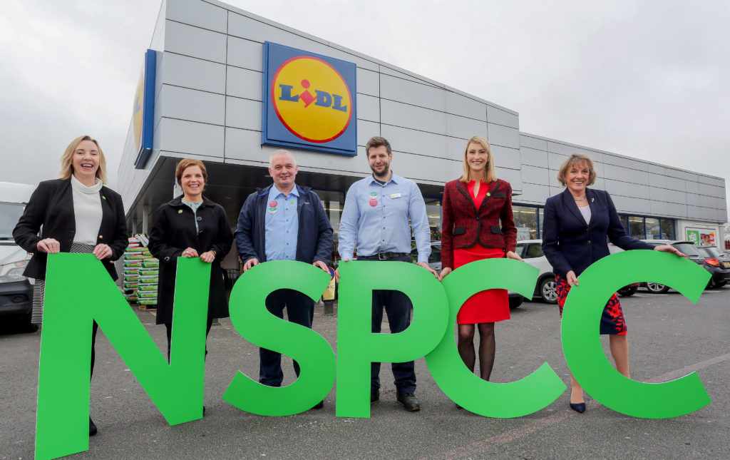
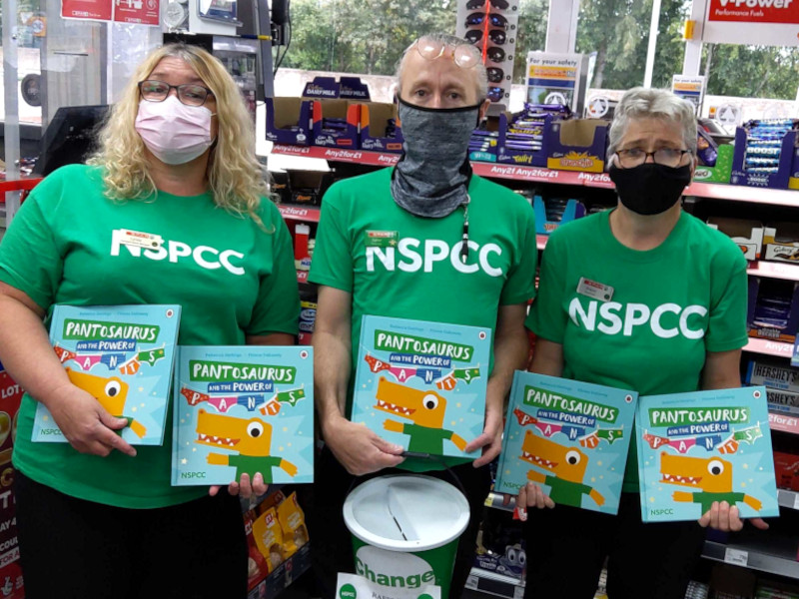
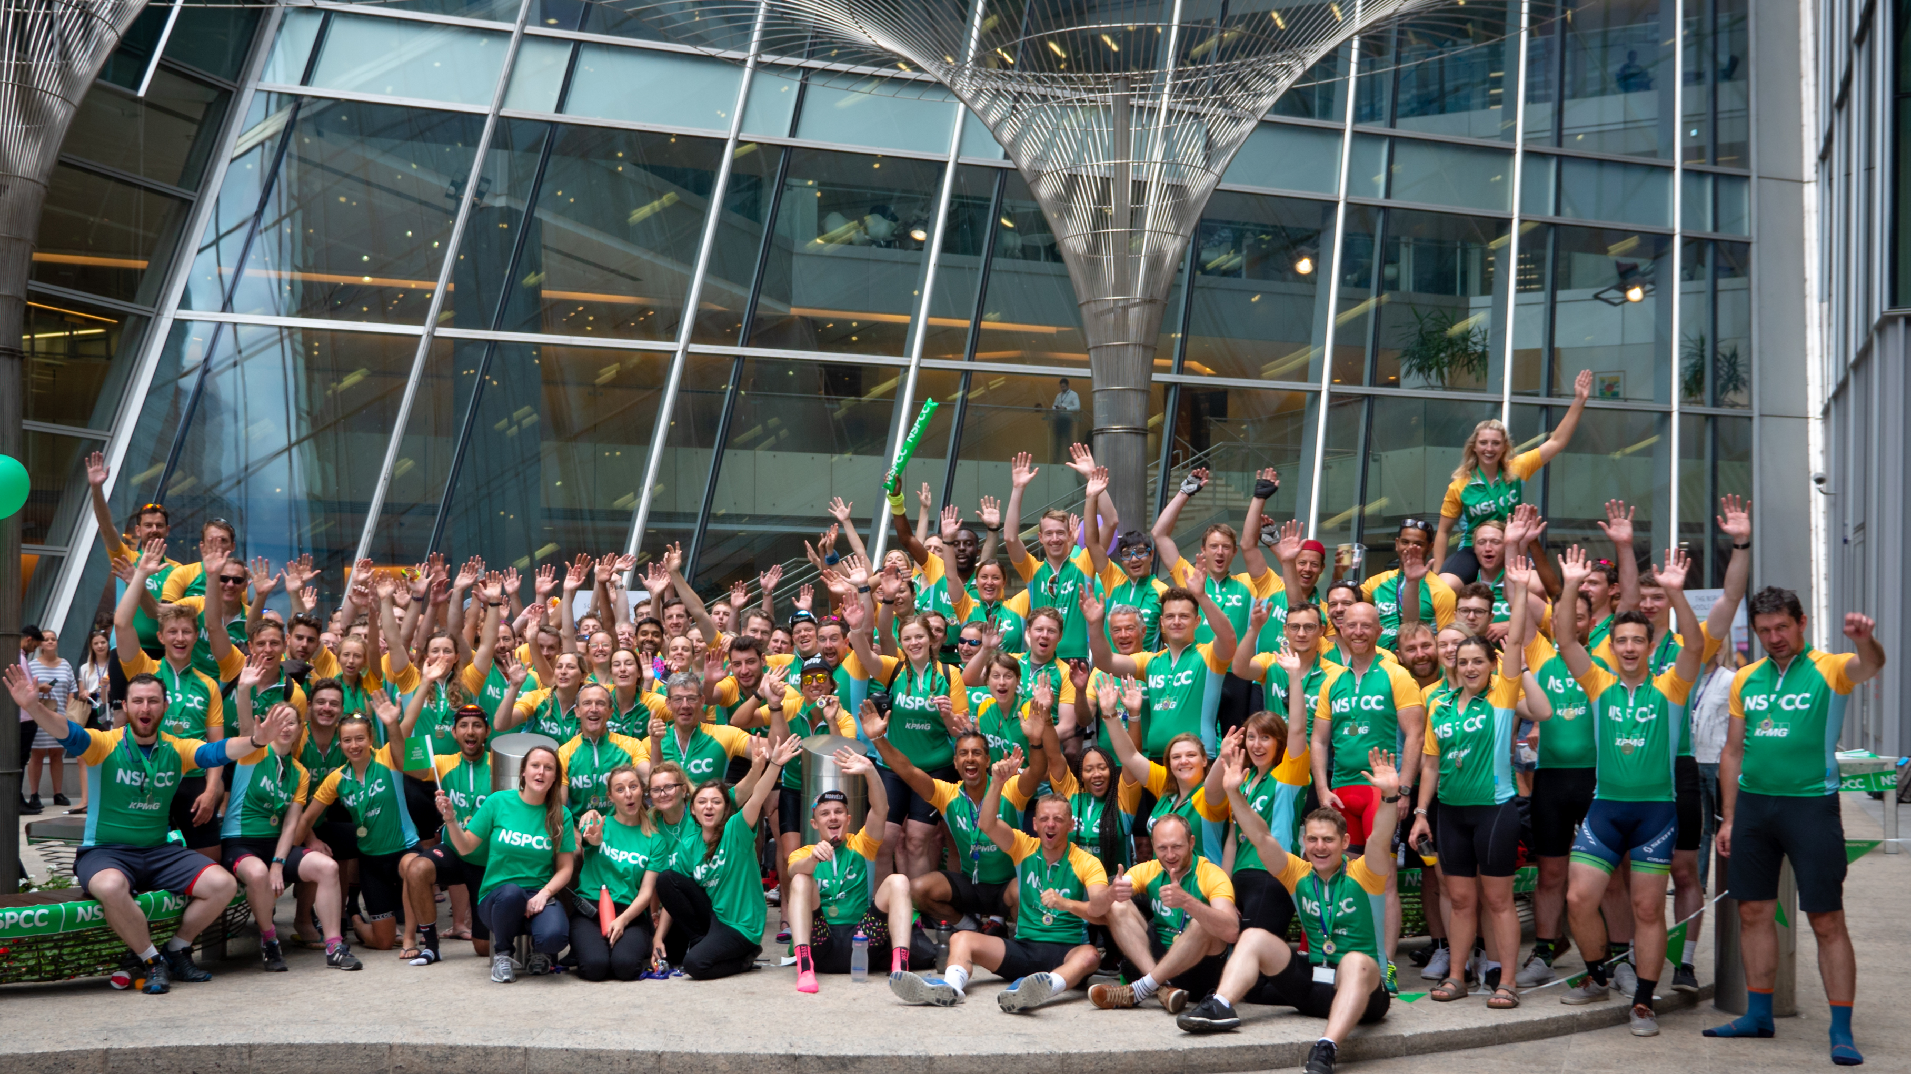
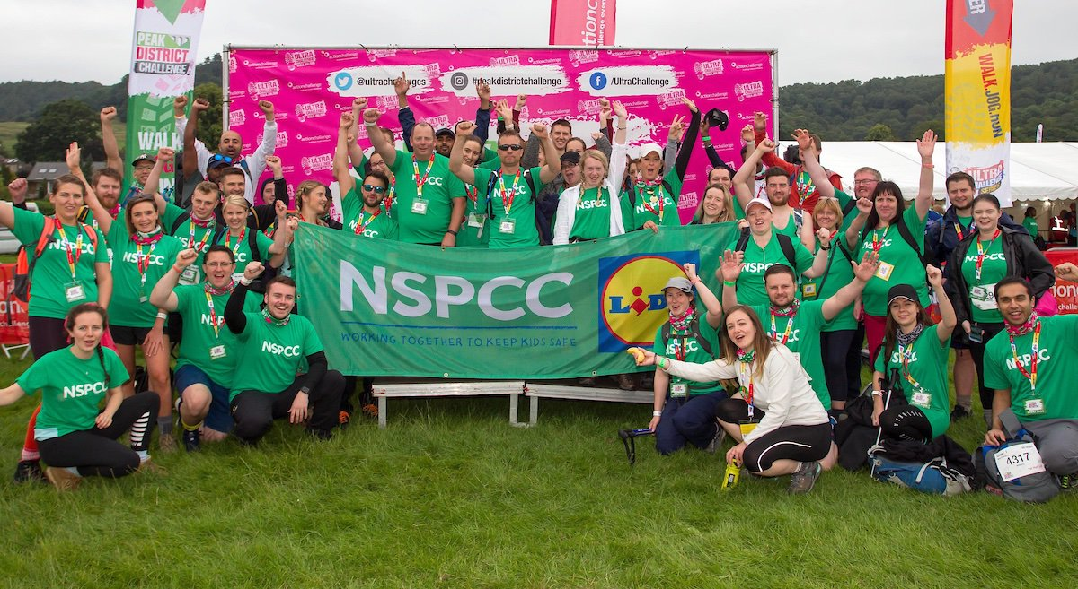
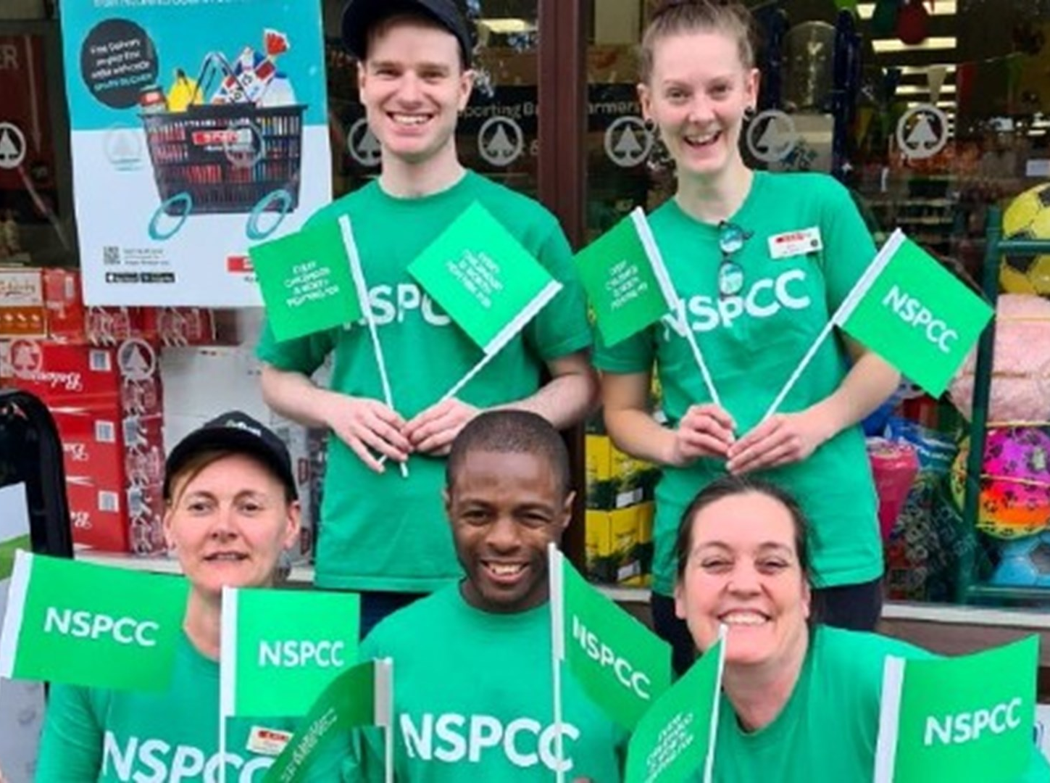
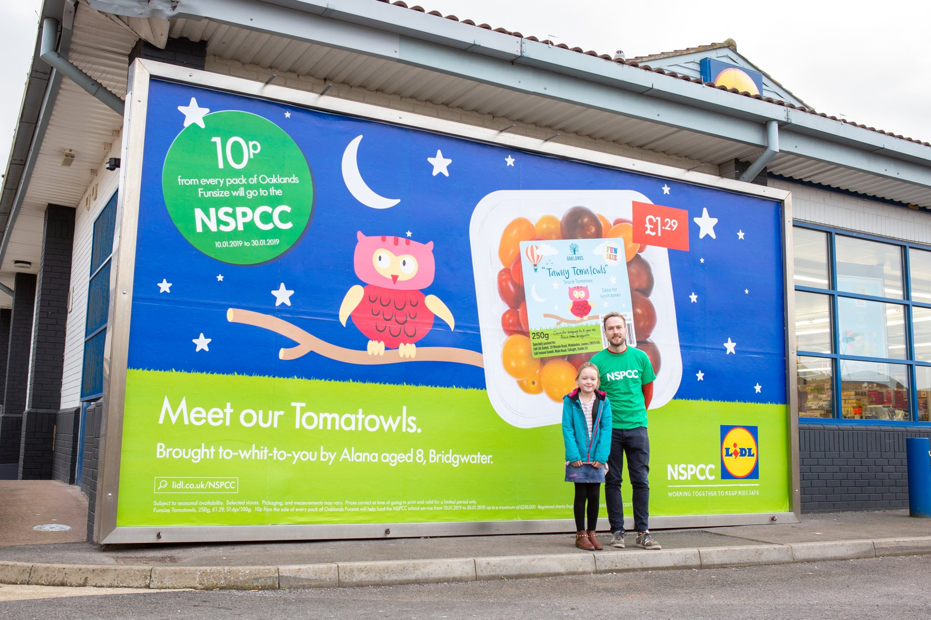
What does a
partnership with
us look like?

Slide 13
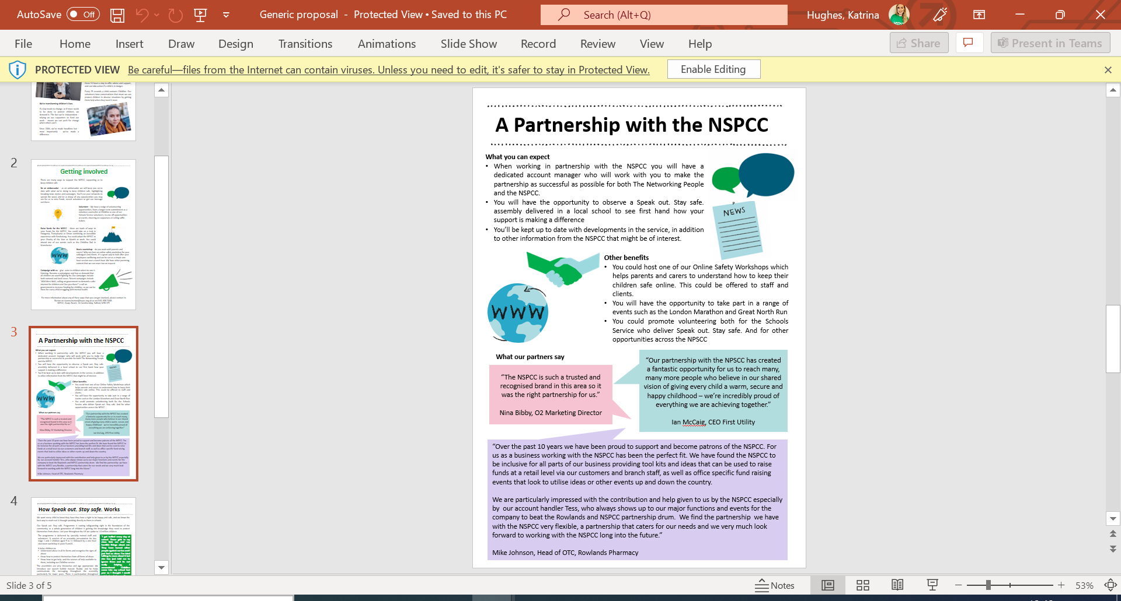
A Partnership with NSPCC NI
Dedicated account manager
Volunteering opportunities
Access to a range of webinars & workshops covering topics from child safety online, to children’s mental health for staff
Annual fundraising events – perfect for team building!
Advice & support on CSR, child protection and more
A united partnership, with a focus on two way communication and collaboration to benefit both.

Slide 14
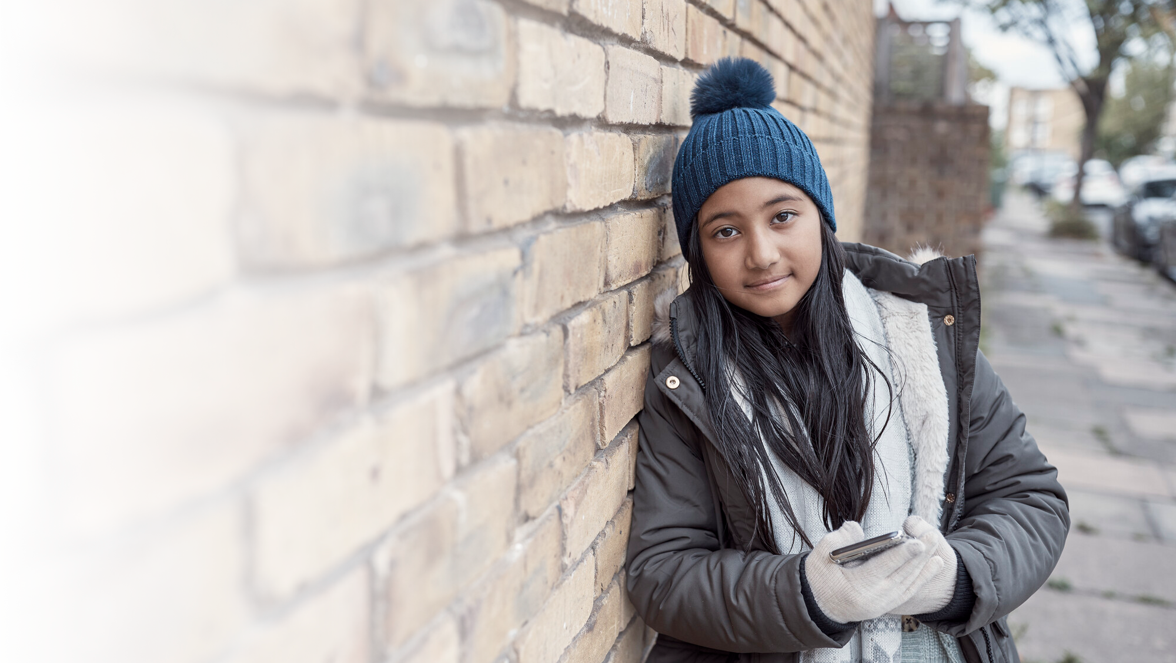


I've been doing a lot better over the past few months and it feels like I've broken out of the dark place I was in. I just want to say thank you for helping me out through all of this. I don't know what I would've done without Childline's help!
If it wasn't for me finding Childline,
I don't know where I would be.”
Girl, aged 15

Slide 15

©National Society for the Prevention of Cruelty to Children (NSPCC) 2023. Registered charity England and Wales 216401. Scotland SC037717 and Jersey 384. Photography by Tom Hull and Patch Dolan. The children pictured are models.

